Slide 1
Embracing interfaith

Slide 2
Course overview
What do we mean by “interfaith”?
Where is the common ground between different traditions?
How might we co-operate to build relations with people of faiths other than our own?
Points to consider when planning an interfaith event

Slide 3
What DO we mean by “INTERFAITH”?
Interfaith recognizes that there are many different ways for individuals to express their spiritual selves and to connect with what is sacred..”
Something that is sacred might be something that is related to, or an expression of, God, including:
objects and symbolism used in religious practices
buildings and spaces designated as places for worship contemplation, and prayer
scriptures, poems, and songs that inspire wonder and awe.”
“
“

Slide 4
What DO we mean by “INTERFAITH”?
Interfaith activities might include…
Recognising the common ground of different faiths
Encouraging dialogue and tolerance of peoples who hold different views by:
offering platforms for representatives of faiths other than our own to speak at meetings
sharing in some form of worship
fostering friendship between communities.

Slide 5
COMPARING BELIEFS–MANY TRADITIONS

Slide 6
COMPARING BELIEFS–CHRISTIAN
Denominations…
Roman Catholic
Anglican/Episcopalian
Baptist
Orthodox
Methodist
Pentecostal
Congregational
and others…
Different views on…
Salvation
Mary
Predestiny
Worship style
Organisation & the Priesthood
and more…

Slide 7
COMPARING BELIEFS–MANY TRADITIONS

Slide 8
FAITH IN RWANDA
2012 Census Data

Slide 9
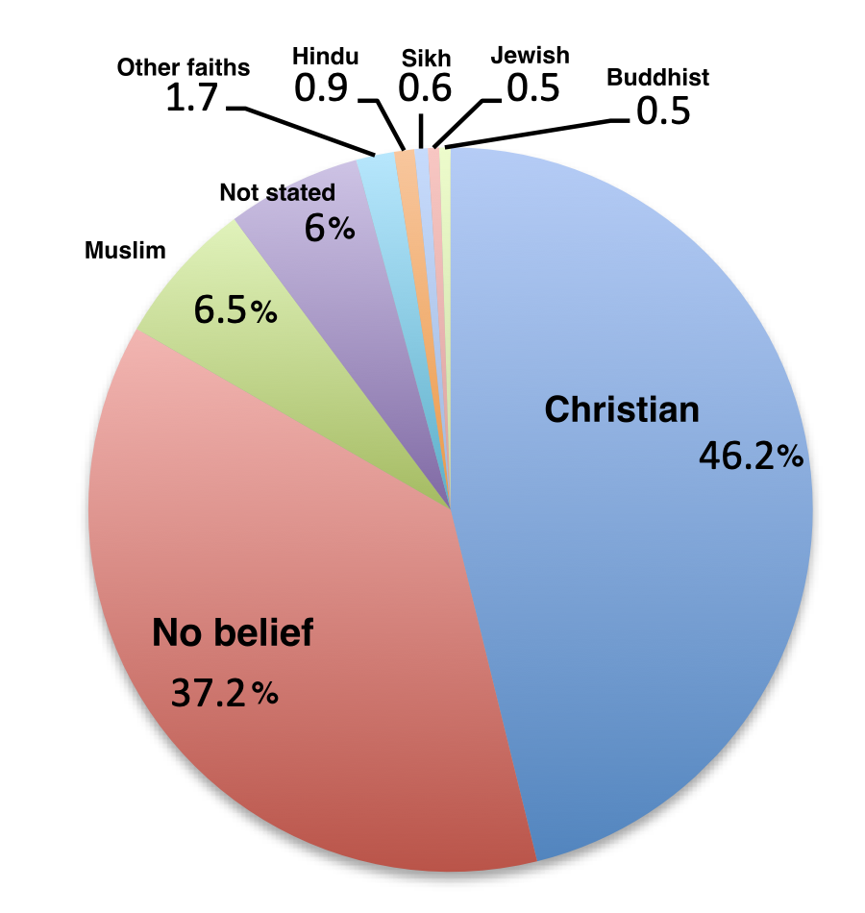
FAITH IN RWANDA AND THE UK
Rwanda (2012)
UK (2021)

Slide 10
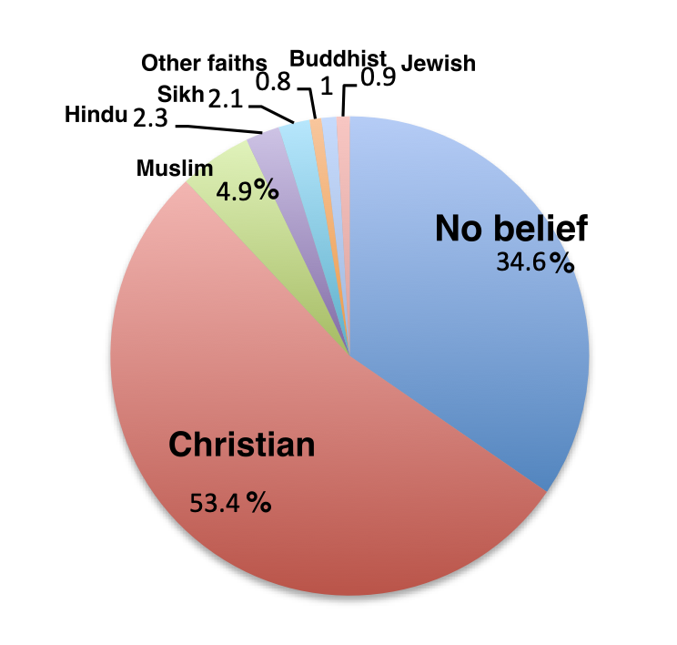
FAITH IN RWANDA AND CANADA
Rwanda (2012)
Canada (2021)

Slide 11
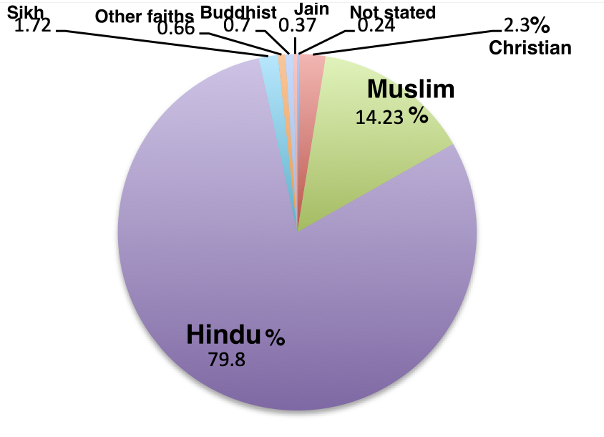
FAITH IN RWANDA AND INDIA
Rwanda (2012)
India (2021)

Slide 12
Challenges
What might challenge you when hearing others talking about their faith?
Why do you think you would be challenged?
How might you respond (say or do) if or when such challenges come?

Slide 13

Lift speech
How might you describe your own faith to someone you met in a lift if they asked you to quickly say what your faith is about?
REMEMBER! While in the lift, you only have up to 60 seconds to give your answer before your fellow passenger reaches their floor!

Slide 14

LOVINGKINDNESS PRAYER
May all beings know their wholeness.
May all beings dwell in the heart.
May all beings be free from suffering.
May all beings be healed.
May all beings be happy.
May all beings be at peace.”
“
AND…
May I know my wholeness
May those I love know their wholeness
May those I find challenging know their wholeness…
and more…

Slide 15
FACILITATING
“
The act of assisting or making easier the progress or improvement of something.”
OR:
The act of helping other people to deal with a process or reach an agreement or solution without getting directly involved in the process.”
“

Slide 16

FACILITATING
Principles
May involve…
Being neutral
Trusting that the group can find its way forward
Letting the group decide how it wants to proceed
Taking away the worry for organizing
Arranging venue + things needed
Planning event outline + content
Making sure all involved know what’s expected
Promoting the event
Making sure guests feel welcome
Introducing the event, suggesting the format, leading
Holding space
Making sure all runs smoothly
Following-up after the event

Slide 17
HOLDING SPACE
Allowing another person to express or find their truth, allowing them to be in their experience, without impacting that experience.”
OR:
Granting room for another person's soul to come out of hiding.”
“
“

Slide 18
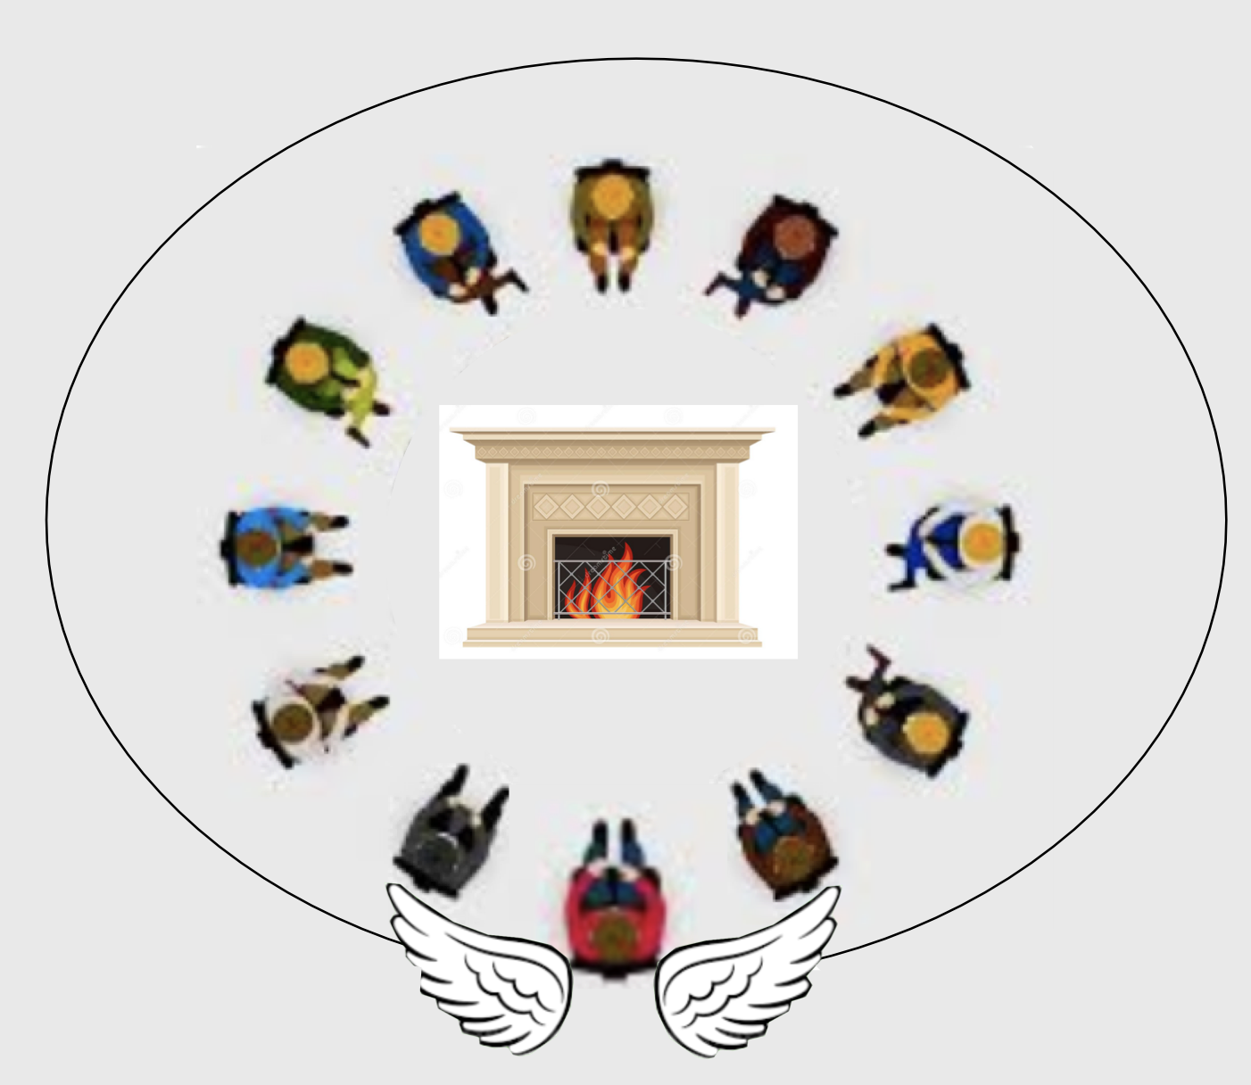
HOLDING SPACE
Principles
Attitudes/Skills needed
Being non-judgemental
Not interfering
Protecting the space
Being hospitable
Deeply listening
Gently observing, but not interfering
Compassion
Being fully present and attentive

Slide 19
Planning an interfaith event
Some considerations…
What are the aims of the event?
Who will the audience you invite be? What preconceptions or concerns may they have?
What form will the event take? How will these meet the event’s aims?
Where will it take place? Is this somewhere that those invited will feel comfortable with?
How much time will you need to arrange the event? Give notice to those involved/invited?
What resources might you need to support the event (if any)? Refreshments? Facilities (e.g. access to toilets, easy access for people less able to stand or walk)?
What contingency planning might be needed?

